Slide 1
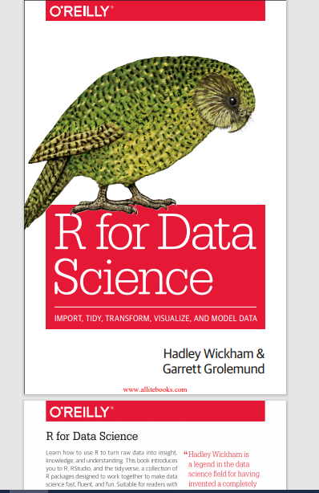
R PROGRAMMING
Hadley Wickham &amp; Garrett Grolemund, “R for Data Science”, Shroff Publishers &amp; Distributors, Mumbai, 2018, First Edition

Slide 2
History
R is a programming language for statistical computing and graphics supported by the R Foundation for Statistical Computing.
The R language is widely used among statisticians and data miners for developing statistical software and data analysis
R was created by Ross Ihaka and Robert Gentleman and is developed by the R Development Core Team
R is an implementation of the S Programming language with additional features
R is named partly after the first names of the first two R authors and partly as a play on the name of S
The project was conceived in 1992, with an initial version released in 1995 and a stable beta version (v1.0) on 29 February 2000.

Slide 3



R Environment
RStudio is an integrated development environment for R
You have to installed R & RStudio in your PC
To download R, go to CRAN , the comprehensive R archive network.
R may be used without RStudio, but RStudio may not be used without R.
R is an interpreted language ; users typically access it through acommand – line interpreter. If a user types 2+2 at the R command prompt and presses enter, the computer replies with 4, as shown below:

Slide 4
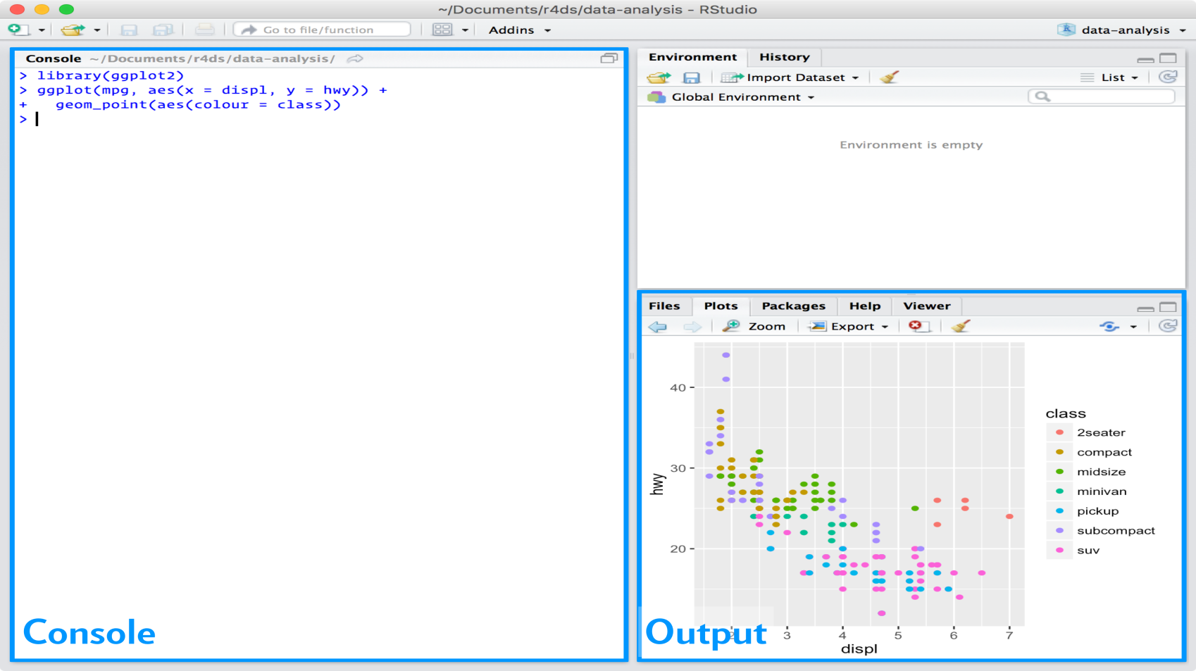
RStudio
RStudio is an integrated development environment, or IDE, for R programming.

Slide 5
Data science
Data science is an exciting discipline that allows you to turn raw data into understanding, insight, and knowledge.
The goal of “R for Data Science” is to help you learn the most important tools in R that will allow you to do data science

Slide 6
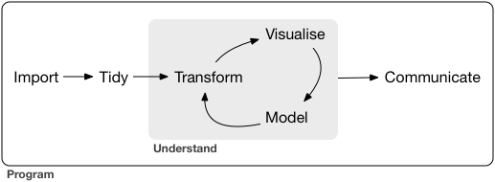
Data science

Slide 7
Unit I Topic –Data Visualization with ggplot2 Sub Topic- Introduction
Visualization is a fundamentally human activity.
A good visualization will show things that you did not expect, or raise new questions about the data.
A good visualization might also hint that you’re asking the wrong question, or you need to collect different data.
Visualization is a great place to start with R programming, to make elegant and informative plots that helps to understand data.
ggplot2 implements the grammar of graphics, a coherent system for describing and building graphs.

Slide 8
ggplot2
Is one of the core members of the tidyverse package.
To access the datasets, help pages, and functions that use in this subject, load the tidyverse package by running the code:
library(tidyverse)
Before call library() install the respective package by using :
install.packages("tidyverse")
install a package once, but reload/call it every time when start a new session
Simply install and call ggplot2 package by running:
install.packages(“ggplot2)
library(ggplot2)

Slide 9
Sub Topic: First steps
The mpg data frame -- found in ggplot2 ( ggplot2::mpg).
A data frame is a rectangular collection (2 dimensional structure) of variables (in the columns) and observations (in the rows).
mpg contains observations collected by the US Environmental Protection Agency on 38 models of car
To know more about data frame, run ?mpg in Rstudio
This data frame consists of 234 rows and 11 variables
For example.. displ, a car’s engine size, in liters.
hwy, a car’s fuel efficiency on the highway

Slide 10
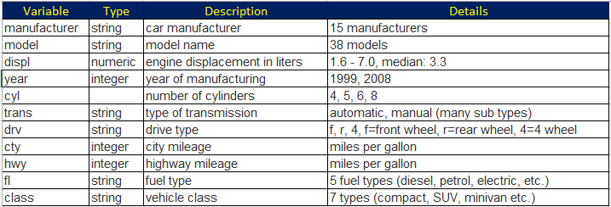
Mpg Data frame Variables

Slide 11
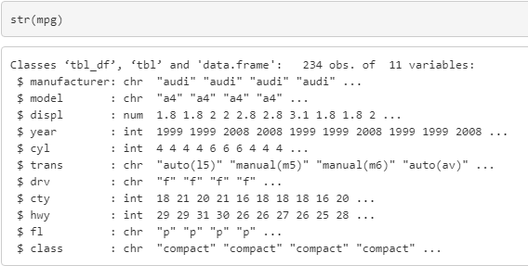
Structure of mpg Dataframe

Slide 12
Try to answer
do cars with big engines use more fuel than cars with small engines?
What does the relationship between engine size and fuel efficiency look like?
Is it positive? Negative? Linear? Nonlinear?
To know answer for the above questions … Creating a ggplot
To plot mpg, run this code to put displ on the x-axis and hwy on the y-axis:
ggplot(data = mpg) + geom_point(mapping = aes(x = displ, y = hwy))

Slide 13
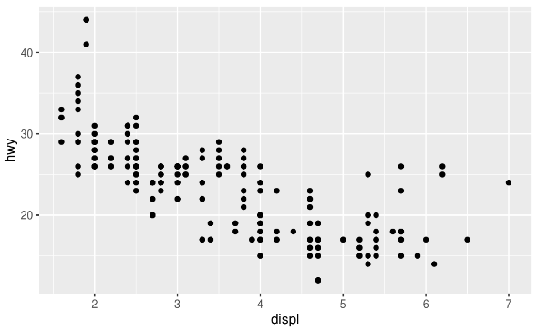
Creating a ggplot
ggplot(data=<data>) + geom_point(mapping = aes(x=<column name>, y=<column name>))
ggplot(data=mpg) + geom_point(mapping = aes(x=displ, y=hwy))
The plot shows a negative relationship between engine size (displ) and fuel efficiency (hwy).
Also depicts, cars with big engines use more fuel.

Slide 14
A graphing template
ggplot(data = <DATA>) +
<GEOM_FUNCTION>(mapping = aes(<MAPPINGS>))
With ggplot2 package, begin a plot with the function ggplot().
ggplot() creates a coordinate system that can add layers.
The first argument of ggplot() is the dataset to use in the graph.
So ggplot(data = mpg) which creates an empty graph
The function geom_point() adds a layer of points to plot, which creates a scatterplot.
ggplot2 comes with many geom functions that each add a different type of layer to a plot.
This defines how variables in dataset are mapped to visual properties.
The mapping argument is always paired with aes(), and the x and y arguments of aes() specify which variables to map to the x and y-axes.
In example… geom_point(mapping = aes(x=displ, y=hwy))

Slide 15

First steps Exercise
1. Run ggplot(data = mpg). What do you see?
ggplot(data = mpg)
This code creates an empty plot. The ggplot() function creates the background of the plot, but since no layers were specified with geom function, nothing is drawn.

Slide 16
First steps Exercise
2. How many rows are in mtcars? How many columns?
There are 32 rows and 11 columns in the mtcars data frame.
nrow(mtcars)
> [1] 32
ncol(mtcars)
#> [1] 11
The glimpse() function also displays the number of rows and columns in a data frame

Slide 17
First steps Exercise
3. What does the drv variable describe? Read the help for ?mpg to find out.
The drv variable is a categorical variable which categorizes cars into front-wheels, rear-wheels, or four-wheel drive.
Value Description
"f“ front-wheel drive
"r“ rear-wheel drive
"4“ four-wheel drive

Slide 18
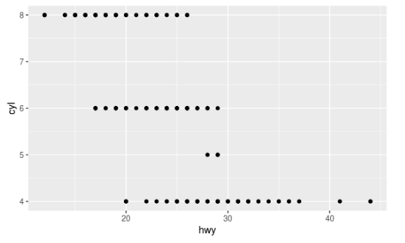
First steps Exercise
4.Make a scatter plot of hwy vs. cyl.
ggplot(data=mpg)+ geom_point(mapping=aes(x = hwy, y = cyl))

Slide 19
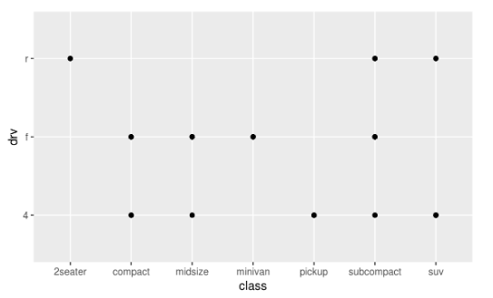
First steps Exercise
5. What happens if you make a scatter plot of class vs drv? Why is the plot not useful?
The resulting scatterplot has only a few points.
ggplot(data=mpg)+ geom_point(mapping= aes(x = class, y = drv))
A scatter plot is not a useful since both drv and class are categorical variables. Since categorical variables typically take a small number of values.
In this data, drv takes 3 values and class takes 7 values, meaning that there are only 21 values that could be plotted on a scatterplot of drv vs. class.

Slide 20
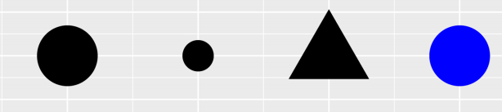
Sub Topic: Aesthetic mappings –Refer Video1
An aesthetic is a visual property of the objects in the plot.
Aesthetics include things like the size, the shape, or the color of points.
Display a point in different ways as shown by changing the values of its aesthetic properties.

Slide 21
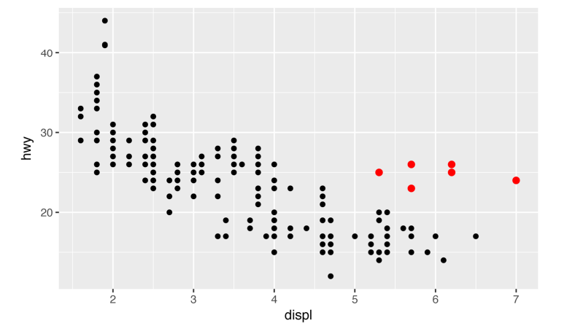
Sub Topic: Aesthetic mappings –Refer Video1
In the following plot, one group of points (highlighted in red) seems to fall outside of the linear trend.
These cars have a higher mileage than expect. How can you explain these cars
One way to test this hypothesis is to look at the class value for each car.
The class variable of the mpg dataset classifies cars into groups such as compact, midsize, and SUV.
If the outlying points are hybrids, they should be classified as compact cars or, perhaps, subcompact cars.

Slide 22
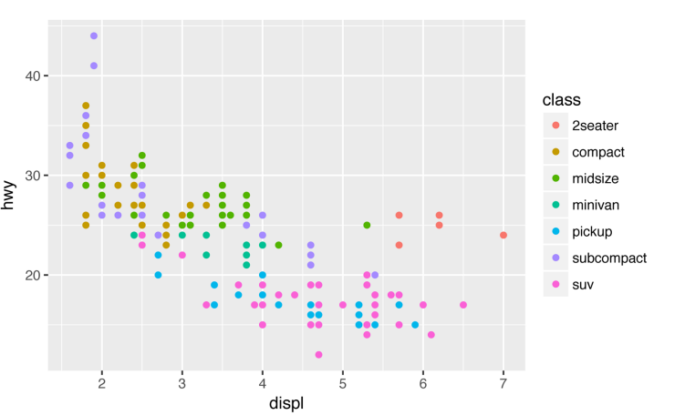
Sub Topic: Aesthetic mappings –Refer Video1
Add a third variable, like class, to a two-dimensional scatterplot by mapping it to an aesthetic.
ggplot(data = mpg) + geom_point(mapping = aes(x = displ, y = hwy, color = class))
ggplot2 will automatically assign a unique level of the aesthetic (here a unique color) to each unique value of the variable, a process known as scaling.
ggplot2 will also add a legend that explains which levels correspond to which values.
The colors reveal that many of the unusual points
are two-seater cars. These cars are Sports cars..

Slide 23
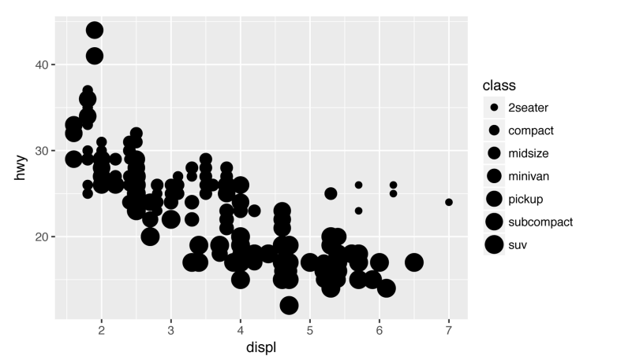
Sub Topic: Aesthetic mappings –Refer Video1
we could have mapped class to the size aesthetic in the same way.
A warning here, because mapping an unordered variable (class) to an ordered aesthetic (size) is not a good idea
ggplot(data = mpg) + geom_point(mapping = aes(x = displ, y = hwy, size = class)) #> Warning: Using size for a discrete variable is not advised.

Slide 24
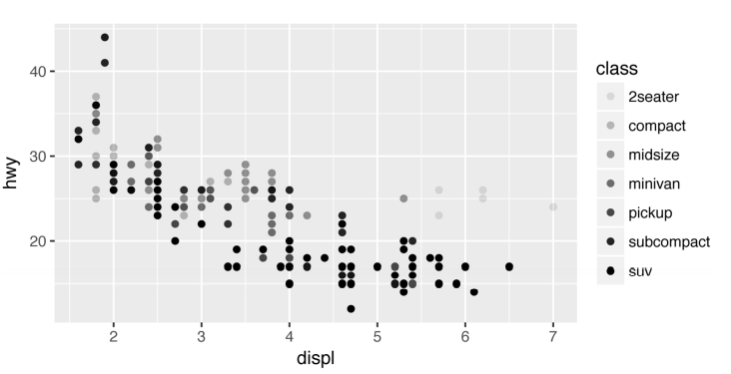
Sub Topic: Aesthetic mappings –Refer Video1
we could have mapped class to the alpha aesthetic, which controls the transparency of the points
ggplot(data = mpg) + geom_point(mapping = aes(x = displ, y = hwy, alpha = class))

Slide 25
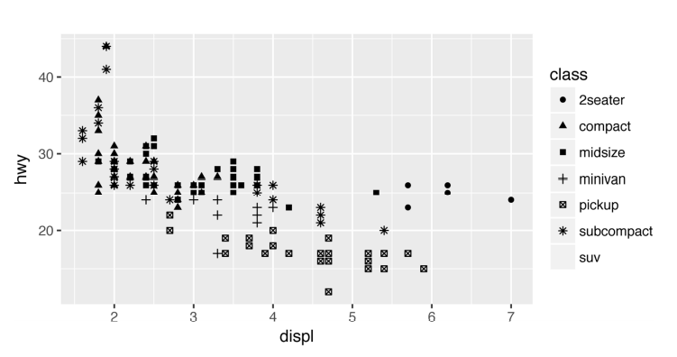
Sub Topic: Aesthetic mappings –Refer Video1
Mapped class to the shape aesthetic, which controls the shape of the points
ggplot(data = mpg) + geom_point(mapping = aes(x = displ, y = hwy, shape = class))
What happened to the SUVs? ggplot2 will only use six shapes at a time.
By default, additional groups will go unplotted when use this aesthetic

Slide 26
Aesthetic mappings Exercises
1. What’s gone wrong with this code? Why are the points not blue?
ggplot(data = mpg) + geom_point(mapping = aes(x = displ, y = hwy, colour = "blue"))
The argument colour = "blue" is included within the mapping argument.
The following code does produces the expected result.
ggplot(data = mpg) + geom_point(mapping = aes(x = displ, y = hwy), colour = "blue")

Slide 27
Aesthetic mappings Exercises
2. Which variables in mpg are categorical? Which variables are continuous? (Hint: type ?mpg to read the documentation for the dataset). How can you see this information when you run mpg?
The following list contains the categorical variables in mpg.
model
trans
drv
fl
class
The following list contains the continuous variables in mpg.
displ
year
cyl
cty
hwy
?mpg & glimpse(mpg) command used to get this information

Slide 28
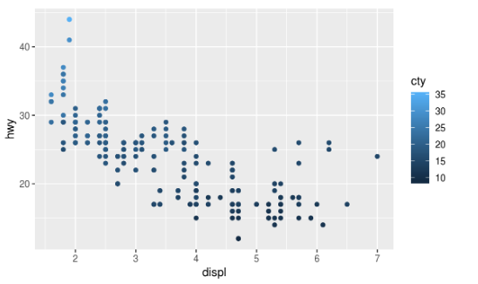
Aesthetic mappings Exercises
3.Map a continuous variable to color, size, and shape. How do these aesthetics behave differently for categorical vs. continuous variables?
The variable cty, city highway miles per gallon, is a continuous variable.
ggplot(data=mpg)+ geom_point(mapping= aes(x = displ, y = hwy, colour = cty))
Instead of using discrete colors, the continuous variable uses a scale that varies from a light to dark blue color.

Slide 29
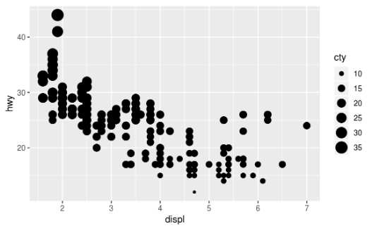
Aesthetic mappings Exercises
ggplot(data=mpg)+ geom_point(mapping= aes(x = displ, y = hwy, size = cty))
When mapped to size, the sizes of the points vary continuously as a function of their size

Slide 30
Aesthetic mappings Exercises
ggplot(data=mpg)+ geom_point(mapping= aes(x = displ, y = hwy, shape = cty))
When a continuous value is mapped to shape, it gives an error.

Slide 31
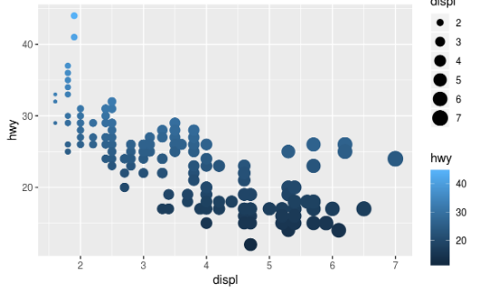
Aesthetic mappings Exercises
4. What happens if you map the same variable to multiple aesthetics?
ggplot(data=mpg)+ geom_point(mapping= aes(x = displ, y = hwy, colour = hwy, size = displ))
Mapping a single variable to multiple
aesthetics is redundant.
Because it is redundant information, in most
cases avoid mapping a single variable
to multiple aesthetics
hwy is mapped to both location on the y-axis and color, and displ is mapped to both location on the x-axis and size

Slide 32
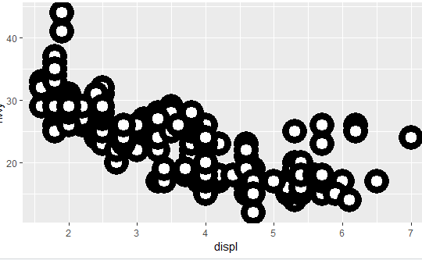
Aesthetic mappings Exercises
5. What does the stroke aesthetic do? What shapes does it work with? (Hint: use ?geom_point)
Stroke changes the size of the border for shapes. These are filled shapes in which the color and size of the border can differ from that of the filled interior of the shape
ggplot(data=mpg)+geom_point(mapping= aes(displ, hwy), shape = 21, colour = "black", fill = "white", size = 5, stroke = 5)

Slide 33
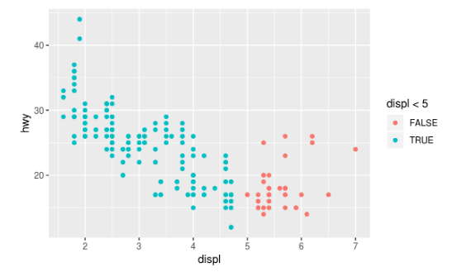
Aesthetic mappings Exercises
6. What happens if you map an aesthetic to something other than a variable name, like aes(colour = displ < 5)?
ggplot(data=mpg)+ geom_point(mapping=aes(x = displ, y = hwy, colour = displ < 5))
The ggplot() function behaves as if a temporary variable was added to the data with values equal to the result of the expression.
In this case, the result of displ < 5 is a logical variable which takes values of TRUE or FALSE.

Slide 34
Sub Topic: Common Problems
Make sure that every " is paired with another ".
Sometimes you’ll run the code and nothing happens.
Check the left-hand side of your con‐ sole: if it’s a +, it means that R doesn’t think you’ve typed a complete expression and it’s waiting for you to finish it.
In this case, it’s usually easy to start from scratch again by pressing Esc to abort processing the current command.
One common problem when creating ggplot2 graphics is to put the + in the wrong place: it has to come at the end of the line, not the start.
ggplot(data = mpg)
+ geom_point(mapping = aes(x = displ, y = hwy))

Slide 35
Sub Topic: Facets-Refer Video 2
One way to add additional variables is with aesthetics.
Another way, particularly useful for categorical variables, is to split plot into facets,
subplots that each display one subset of the data.
To facet the plot by a single variable, use facet_wrap().
The first argument of facet_wrap() should be a formula, which create with ~ followed by a variable name
The variable that pass to facet_wrap() should be discrete.

Slide 36
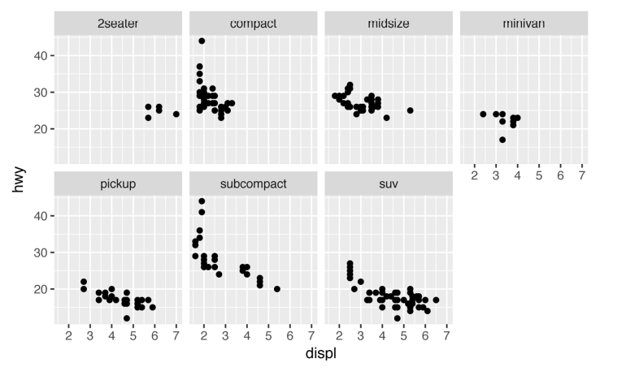
Sub Topic: Facets-Refer Video 2
ggplot(data = mpg) + geom_point(mapping = aes(x = displ, y = hwy)) + facet_wrap(~ class, nrow = 2)

Slide 37
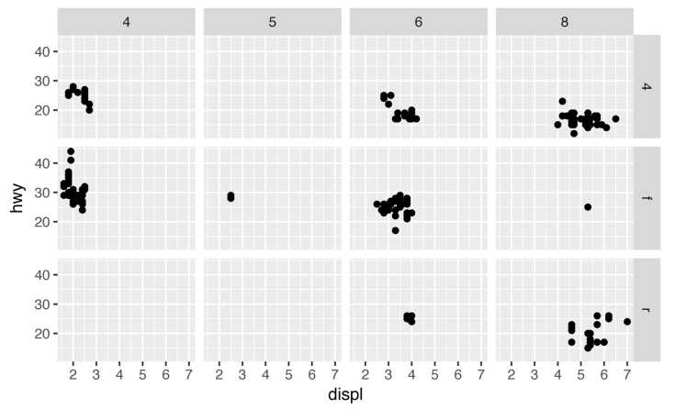
Sub Topic: Facets-Refer Video 2
To facet your plot on the combination of two variables
Add facet_grid() to plot call.
The first argument of facet_grid() is also a formula.
This time the formula should contain two variable names separated by a ~
ggplot(data = mpg) + geom_point(mapping = aes(x = displ, y = hwy)) + facet_grid(drv ~ cyl)
If you prefer to not facet in the rows or columns dimension, use a . instead of a variable name, e.g., + facet_grid(. ~ cyl).

Slide 38
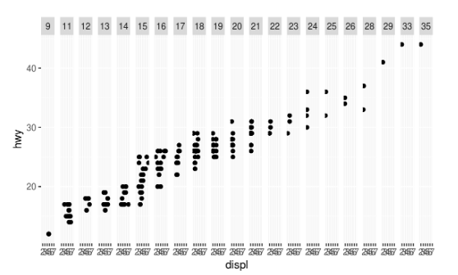
Sub Topic: Facets-Refer Video 2
1. What happens if you facet on a continuous variable?
ggplot(data=mpg, geom_point( aes(x = displ, y = hwy)) + facet_grid(. ~ cty)
The continuous variable is converted to a categorical variable, and the plot contains a facet for each distinct value.

Slide 39
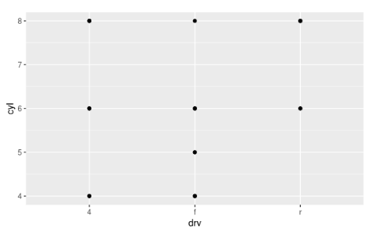
Sub Topic: Facets-Refer Video 2
2. What do the empty cells in plot with facet_grid(drv ~ cyl) mean? How do they relate to this plot?
ggplot(data = mpg) + geom_point(mapping = aes(x = drv, y = cyl))

Slide 40
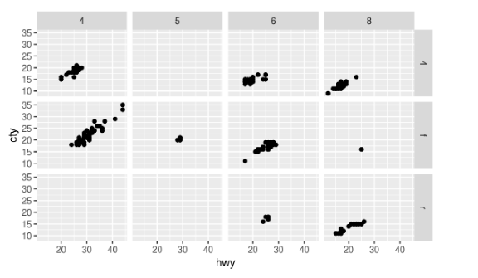
Sub Topic: Facets-Refer Video 2
ggplot(data = mpg) + geom_point(mapping = aes(x = hwy, y = cty)) + facet_grid(drv ~ cyl)
The empty cells (facets) in this plot are combinations of drv and cyl that have no observations

Slide 41
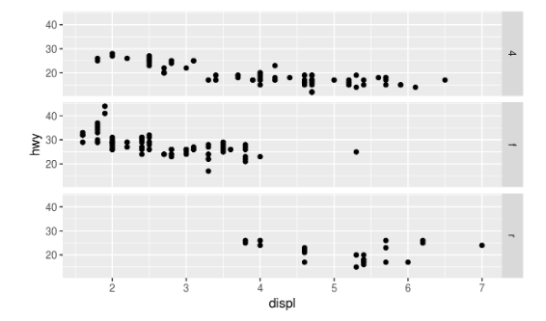
Sub Topic: Facets-Refer Video 2
3.What plots does the following code make? What does . do?
The symbol . ignores that dimension when faceting. For example, drv ~ . facet by values of drv on the y-axis.
ggplot(data = mpg) + geom_point(mapping = aes(x = displ, y = hwy)) + facet_grid(drv ~ .)

Slide 42
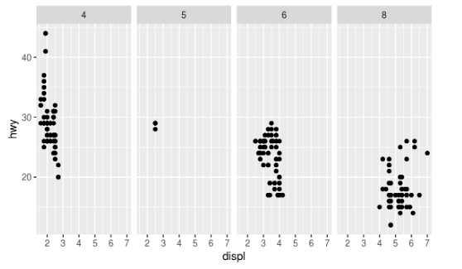
Sub Topic: Facets-Refer Video 2
While, . ~ cyl will facet by values of cyl on the x-axis.
ggplot(data = mpg) + geom_point(mapping = aes(x = displ, y = hwy)) + facet_grid(. ~ cyl)

Slide 43
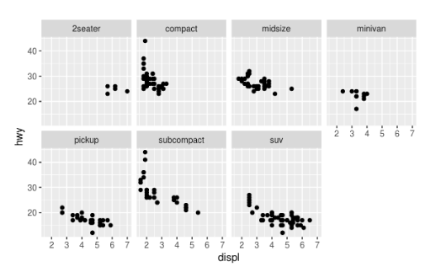
Sub Topic: Facets-Refer Video 2
4. Take the first faceted plot in this section:
ggplot(data = mpg) + geom_point(mapping = aes(x = displ, y = hwy)) + facet_wrap(~class, nrow = 2)
What are the advantages to using faceting instead of the colour aesthetic? What are the disadvantages? How might the balance change if you had a larger dataset?

Slide 44
Facets-Exercise Refer Video2
Using the same x- and y-scales for all facets makes it easier to compare values of observations across categories
Disadvantages of encoding the class variable with facets instead of the color aesthetic include the difficulty of comparing the values of observations between categories since the observations for each category are on different plots.
As the number of categories increases, the difference between colors decreases, to the point that the color of categories will no longer be visually distinct.

Slide 45
Facets-Exercise Refer Video2
5. Read ?facet_wrap. What does nrow do? What does ncol do? What other options control the layout of the individual panels? Why doesn’t facet_grid() have nrow and ncol variables?
The arguments nrow (ncol) determines the number of rows (columns) to use when laying out the facets. It is necessary since facet_wrap() only facets on one variable.
The nrow and ncol arguments are unnecessary for facet_grid() since the number of unique values of the variables specified in the function determines the number of rows and columns.

Slide 46
Facets-Exercise Refer Video2
6. When using facet_grid() you should usually put the variable with more unique levels in the columns. Why?
There will be more space for columns if the plot is laid out horizontally (landscape).

Slide 47
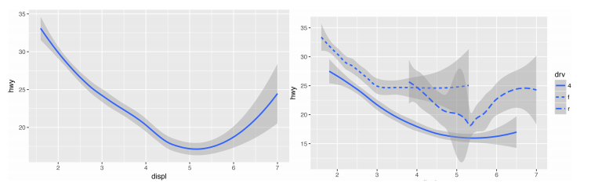
Sub Topic: Geometric objects
A geom is the geometrical object that a plot uses to represent data.
For example, bar charts use bar geoms, line charts use line geoms, boxplots use box plot geoms, and so on.
Scatter plots use the point geom.
Both plots contain the same x variable and the same y variable, and both describe the same data. But the plots are not identical.
Each plot uses a different visual object to represent the data.

Slide 48
Sub Topic: Geometric objects
ggplot(data = mpg) +
geom_smooth(mapping = aes(x = displ, y = hwy))
ggplot(data = mpg) +
geom_smooth(mapping = aes(x = displ, y = hwy, linetype = drv))
Here geom_smooth() separates the cars into three lines based on their drv value.
One line describes all of the points with a 4 value, one line describes all of the points with an f value, and one line describes all of the points with an r value.

Slide 49
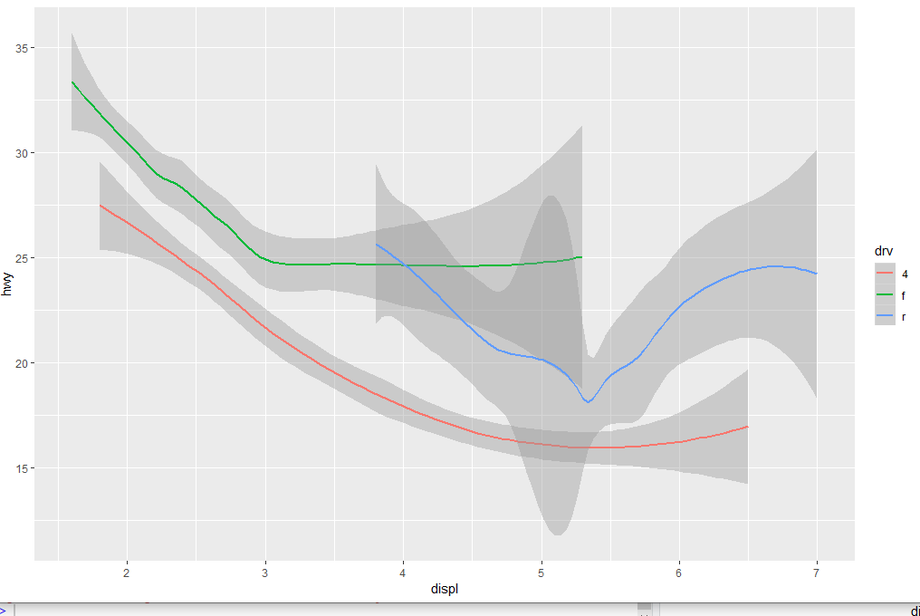
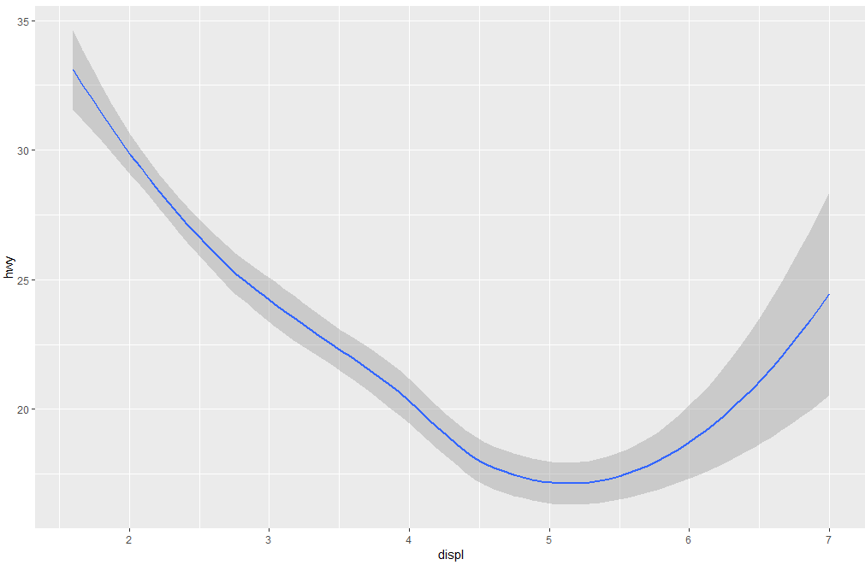
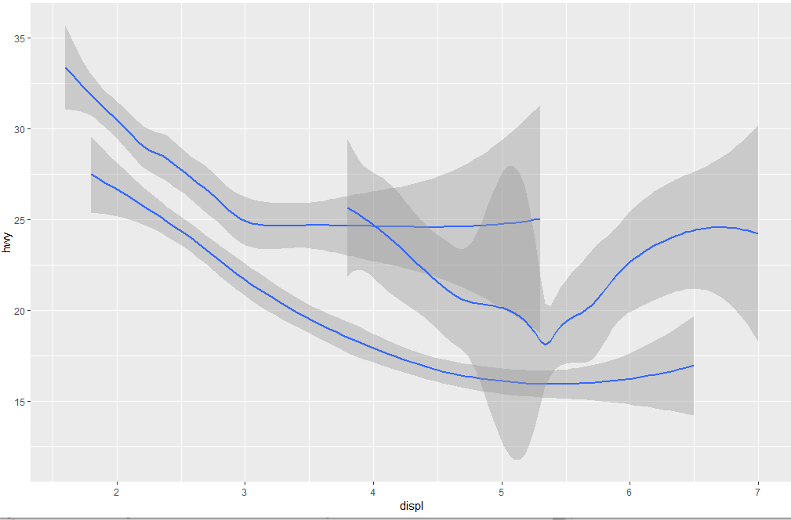
Sub Topic: Geometric objects
ggplot(data = mpg) +
geom_smooth(mapping = aes(x = displ, y = hwy))
ggplot(data = mpg) +
geom_smooth(mapping = aes(x = displ, y = hwy, group = drv))
ggplot(data = mpg) +
geom_smooth( mapping = aes(x = displ, y = hwy, color = drv), show.legend = TRUE )

Slide 50
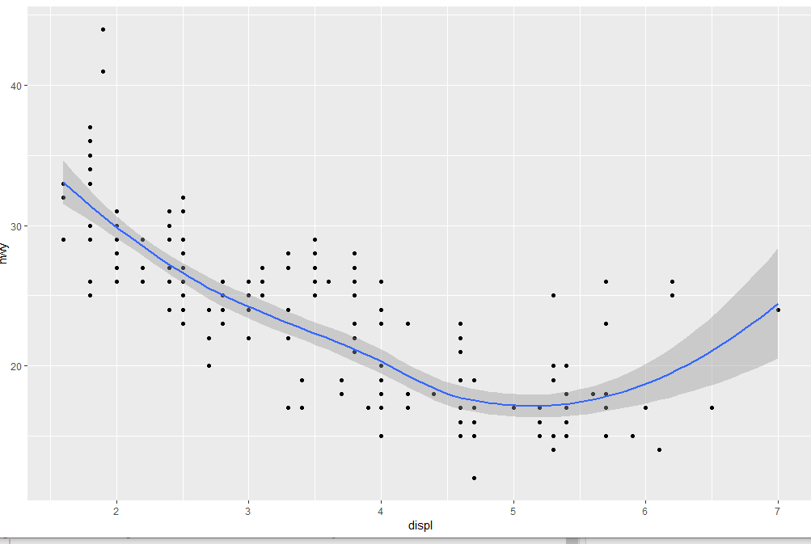
Sub Topic: Geometric objects
To display multiple geoms in the same plot, add multiple geom functions to ggplot():
ggplot(data = mpg) + geom_point(mapping = aes(x = displ, y = hwy)) + geom_smooth(mapping = aes(x = displ, y = hwy))
ggplot2 allows global mappings that apply to each geom in the graph.
In other words, this code will produce the same plot as the previous code:
ggplot(data = mpg, mapping = aes(x = displ, y = hwy)) + geom_point() + geom_smooth()

Slide 51
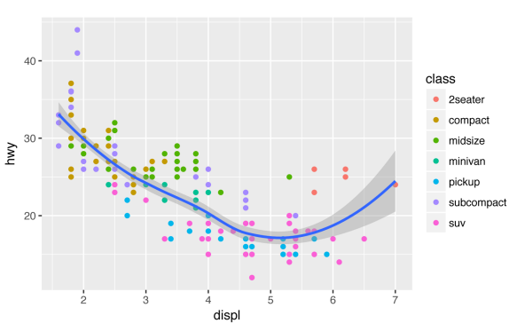
Different aesthetics in different layers
ggplot(data = mpg, mapping = aes(x = displ, y = hwy)) + geom_point(mapping = aes(color = class)) + geom_smooth()

Slide 52
Geometric objects- Exercises
1. What geom would you use to draw a line chart? A boxplot? A histogram? An area chart?
line chart: geom_line()
boxplot: geom_boxplot()
histogram: geom_histogram()
area chart: geom_area()

Slide 53
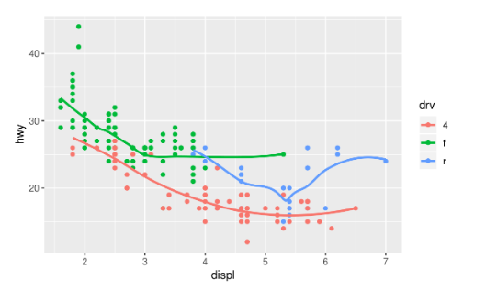
Geometric objects- Exercises
2. Run this code in your head and predict what the output will look like. Then, run the code in R and check your predictions.
ggplot(data = mpg, mapping = aes(x = displ, y = hwy, colour = drv)) + geom_point() + geom_smooth(se = FALSE)
This code produces a scatter plot with displ on the x-axis, hwy on the y-axis, and the points colored by drv. There will be a smooth line, without standard errors, fit through each drv group.

Slide 54
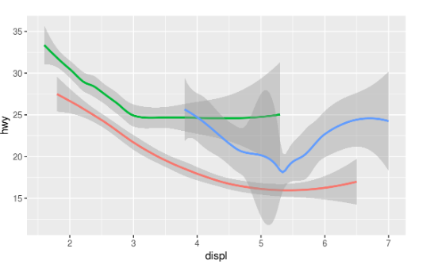
Geometric objects- Exercises
3. What does show.legend = FALSE do? What happens if you remove it? Why do you think I used it earlier in the chapter?
The theme option show.legend = FALSE hides the legend box.
ggplot(data = mpg) + geom_smooth( mapping = aes(x = displ, y = hwy, colour = drv), show.legend = FALSE )

Slide 55
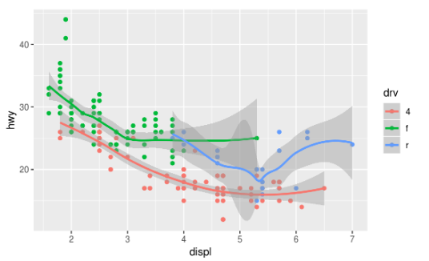
Geometric objects- Exercises
4. What does the se argument to geom_smooth() do?
It adds standard error bands to the lines.
ggplot(data = mpg, mapping = aes(x = displ, y = hwy, colour = drv)) + geom_point() + geom_smooth(se = TRUE)

Slide 56
Geometric objects- Exercises
5.Will these two graphs look different? Why/why not?
ggplot(data = mpg, mapping = aes(x = displ, y = hwy)) + geom_point() + geom_smooth()
ggplot() + geom_point(data = mpg, mapping = aes(x = displ, y = hwy)) + geom_smooth(data = mpg, mapping = aes(x = displ, y = hwy))
No. Because both geom_point() and geom_smooth() will use the same data and mappings. They will inherit those options from the ggplot() object, so the mappings don’t need to specified again.

Slide 57
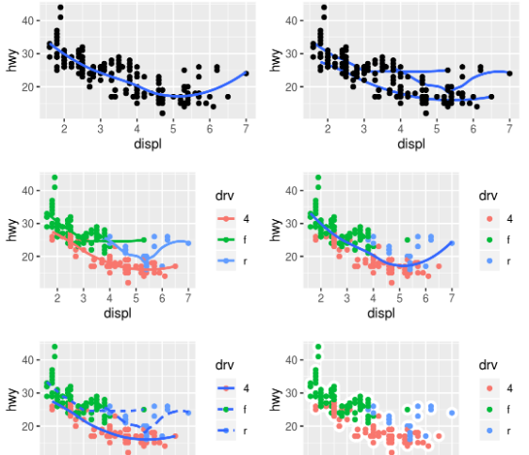
Geometric objects- Exercises
Recreate R Code
To generate the plots

Slide 58
Geometric objects- Exercises
ggplot(mpg, aes(x = displ, y = hwy)) + geom_point() + geom_smooth(se = FALSE)
ggplot(mpg, aes(x = displ, y = hwy)) + geom_smooth(aes(group=drv), se = FALSE) + geom_point()
ggplot(mpg, aes(x = displ, y = hwy, colour = drv)) + geom_point() + geom_smooth(se = FALSE)
ggplot(mpg, aes(x = displ, y = hwy)) + geom_point(aes(colour = drv)) + geom_smooth(se = FALSE)
ggplot(mpg, aes(x = displ, y = hwy)) + geom_point(aes(colour = drv)) + geom_smooth(aes(linetype = drv), se = FALSE)
ggplot(mpg, aes(x = displ, y = hwy)) + geom_point(size=4, color="white")+geom_point(aes(colour = drv))

Slide 59
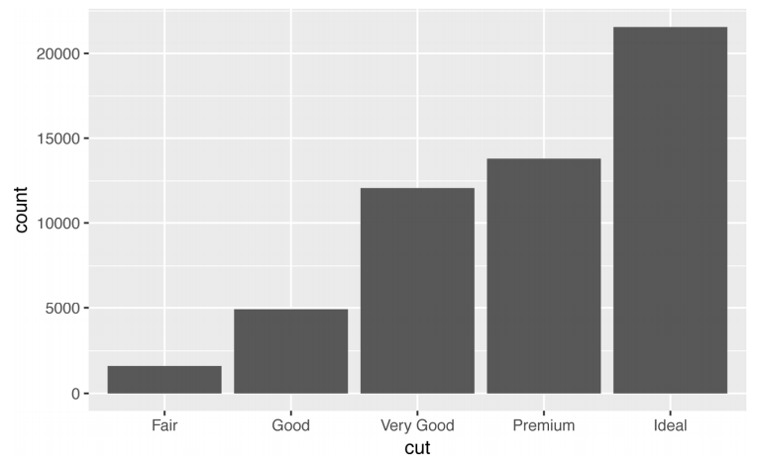
Sub Topic: Statistical Transformations-Refer Video 3
The diamonds dataset comes in ggplot2 and contains information about ~54,000 diamonds, including the price, carat, color, clarity, and cut of each diamond.
The chart shows that more diamonds are available with high-quality cuts than with low quality cuts:
ggplot(data = diamonds) + geom_bar(mapping = aes(x = cut))

Slide 60
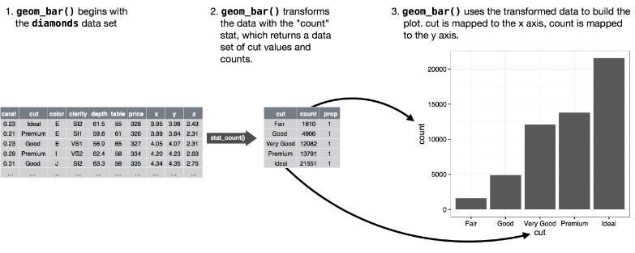
Sub Topic: Statistical Transformations-Refer Video 3

Slide 61
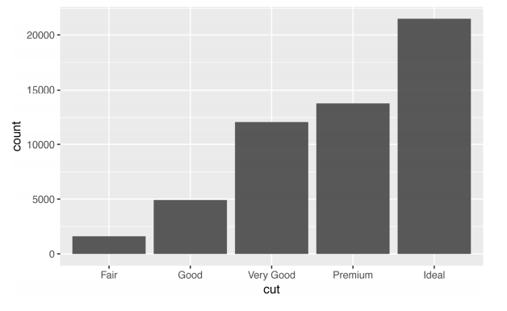
Sub Topic: Statistical Transformations-Refer Video 3
Generally use geoms and stats interchangeably.
For example, you can re-create the previous plot using stat_count() instead of geom_bar():
ggplot(data = diamonds) + stat_count(mapping = aes(x = cut))

Slide 62
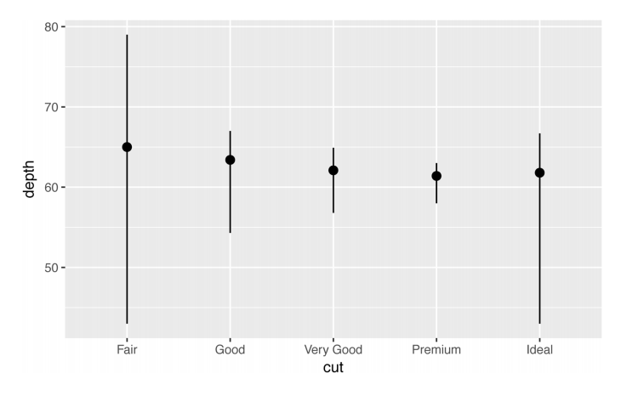
Sub Topic: Statistical Transformations-Refer Video 3
use stat_sum mary(), which summarizes the y values for each unique x value, to draw attention to the summary that you’re computing:
ggplot(data = diamonds) + stat_summary( mapping = aes(x = cut, y = depth), fun.ymin = min, fun.ymax = max, fun.y = median )
ggplot2 provides over 20 stats to use.

Slide 63
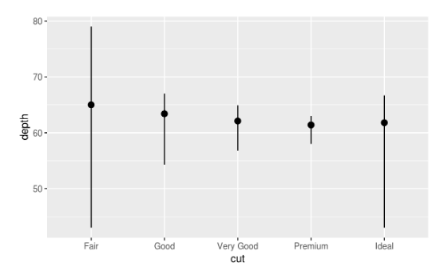
Statistical transformations -Exercises- Refer Video 3
1. What is the default geom associated with stat_summary()? How could you rewrite the previous plot to use that geom function instead of the stat function?
ggplot(data = diamonds) + stat_summary( mapping = aes(x = cut, y = depth), fun.ymin = min, fun.ymax = max, fun.y = median )

Slide 64
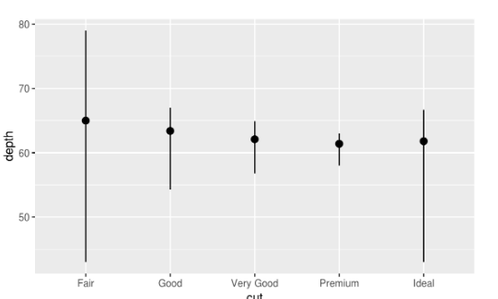
Statistical transformations -Exercises –Refer Video 3
The default geom for stat_summary() is geom_pointrange(). can add the argument stat = "summary" to use stat_summary() .
ggplot(data = diamonds) + geom_pointrange( mapping = aes(x = cut, y = depth), stat = "summary", fun.ymin = min, fun.ymax = max, fun.y = median )

Slide 65
Statistical transformations -Exercises –Refer Video 3
2. What does geom_col() do? How is it different to geom_bar()?
The geom_col() function expects that the data contains x values and y values which represent the bar height.
The geom_bar() function only expects an x variable.

Slide 66
Statistical transformations -Exercises –Refer Video 3
3. What variables does stat_smooth() compute? What parameters control its behavior?
The function stat_smooth() calculates the following variables:
y: predicted value
ymin: lower value of the confidence interval
ymax: upper value of the confidence interval
se: standard error
The parameters that control the behavior of stat_smooth() include
method: the method used to
formula: the formula are parameters such as method which determines which method is used to calculate the predictions and confidence interval, and some other arguments that are passed to that.
na.rm:

Slide 67
Statistical transformations -Exercises – Refer Video 3
4. In our proportion bar chart, we need to set group = 1 Why? In other words, what is the problem with these two graphs?
ggplot(data = diamonds) + geom_bar(mapping = aes(x = cut, y = ..prop..))
gplot(data = diamonds) + geom_bar(mapping = aes(x = cut, fill = color, y = ..prop..))
The problem with these two plots is that the proportions are calculated within the groups.
The following code will produce the intended stacked bar charts for the case with no fill aesthetic.
ggplot(data = diamonds) + geom_bar(mapping = aes(x = cut, y = ..prop.., group = 1))

Slide 68
Sub Topic: Position adjustments
The stacking is performed automatically by the position adjustment specified by the position argument
use one of three other options: "identity", "dodge" or "fill“ for position argument
position = "identity" will place each object exactly where it falls in the context of the graph.
This is not very useful for bars, because it overlaps them.
To see that overlapping we either need to make the bars slightly transparent by setting alpha to a small value, or completely transparent by setting fill = NA:

Slide 69
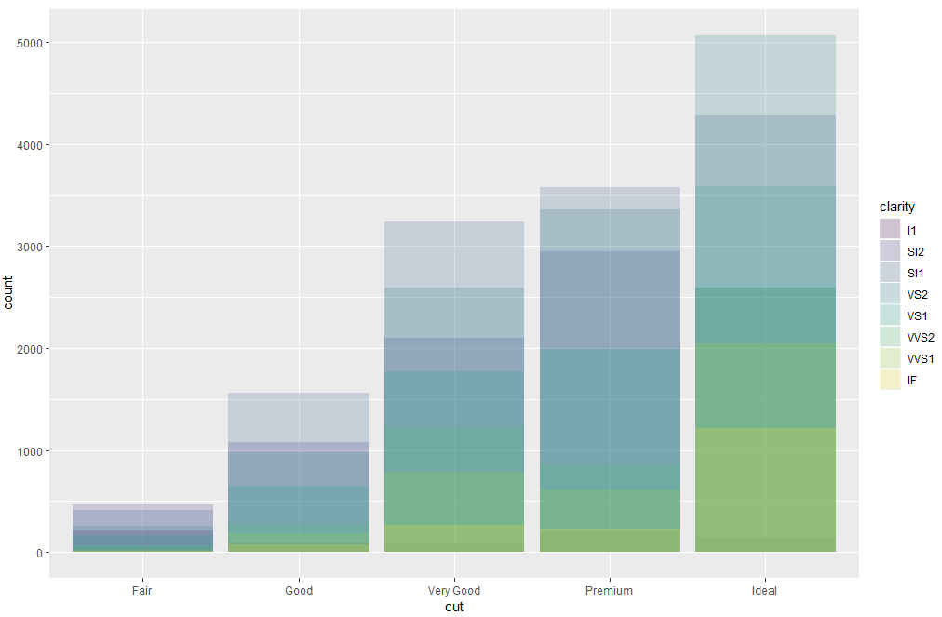
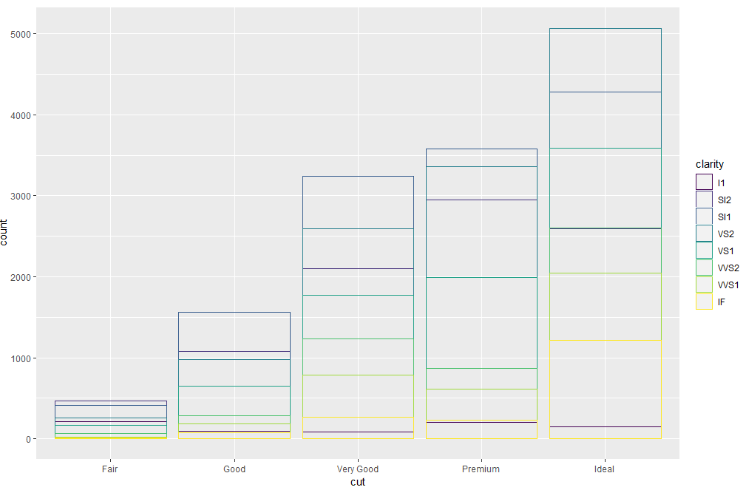
Sub Topic: Position adjustments
ggplot( data = diamonds, mapping = aes(x = cut, fill = clarity) ) + geom_bar(alpha = 1/5, position = "identity")
ggplot( data = diamonds, mapping = aes(x = cut, color = clarity) ) + geom_bar(fill = NA, position = "identity")

Slide 70
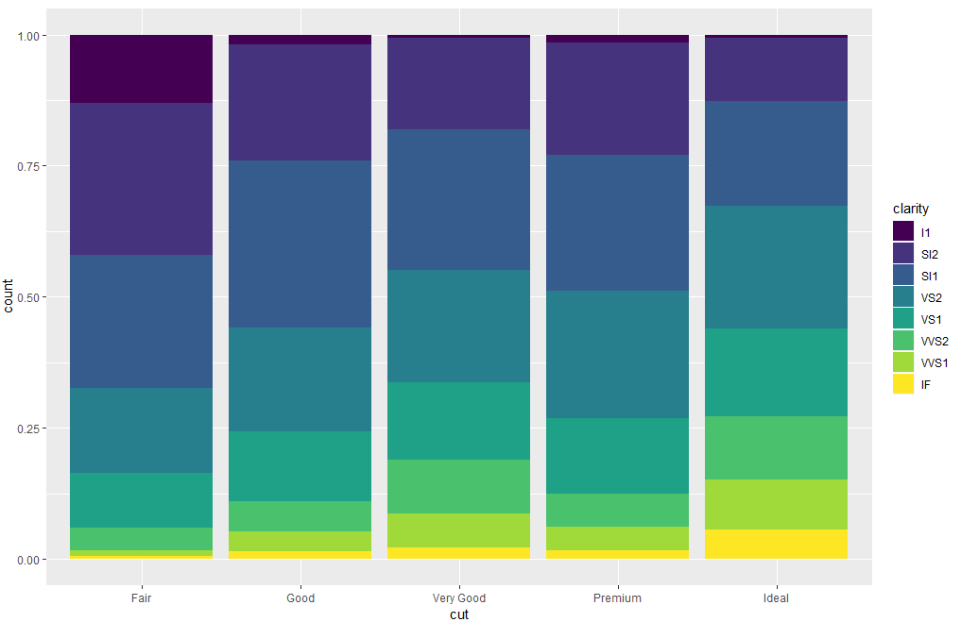
Sub Topic: Position adjustments
position = "fill" works like stacking, but makes each set of stacked bars the same height. This makes it easier to compare proportions across groups:
ggplot(data = diamonds) + geom_bar( mapping = aes(x = cut, fill = clarity), position = "fill" )

Slide 71
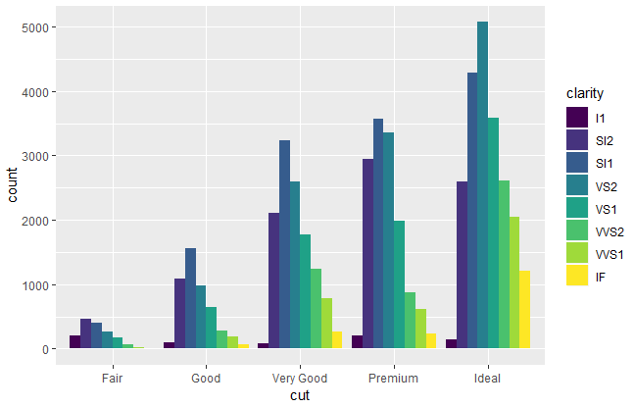
Sub Topic: Position adjustments
position = "dodge" places overlapping objects directly beside one another. This makes it easier to compare individual values:
ggplot(data = diamonds) + geom_bar( mapping = aes(x = cut, fill = clarity), position = "dodge" )

Slide 72
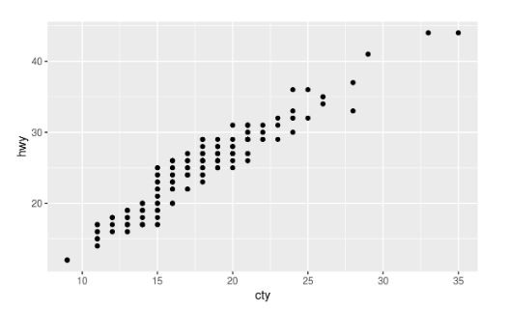
Position adjustments-Exercises
1.What is the problem with this plot? How could you improve it?
ggplot(data = mpg, mapping = aes(x = cty, y = hwy)) + geom_point()

Slide 73
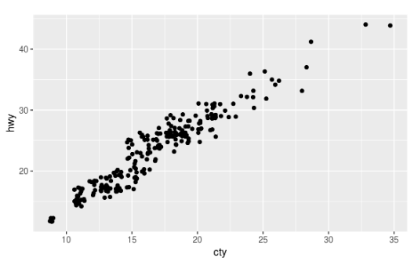
Position adjustments-Exercises
There is overplotting because there are multiple observations for each combination of cty and hwy values.
Can improve the plot by using a jitter position adjustment to decrease overplotting.
ggplot(data = mpg, mapping = aes(x = cty, y = hwy)) + geom_point(position = "jitter")

Slide 74
Position adjustments-Exercises
2. What parameters to geom_jitter() control the amount of jittering?
From the geom_jitter() documentation, there are two arguments to jitter:
width controls the amount of vertical displacement, and
height controls the amount of horizontal displacement.
The defaults values of width and height will introduce noise in both directions
When width = 0 there is no horizontal jitter. When height = 0, there is no vertical jitter.
When width = 20, there is too much horizontal jitter.
ggplot(data = mpg, mapping = aes(x = cty, y = hwy)) + geom_jitter(width = 20)
When height = 15, there is too much vertical jitter.
ggplot(data = mpg, mapping = aes(x = cty, y = hwy)) + geom_jitter(height = 15)

Slide 75
Position adjustments-Exercises
3. Compare and contrast geom_jitter() with geom_count()
The geom geom_jitter() “jitters” the locations of points slightly. This method reduces overplotting since two points with the same location are unlikely to have the same random variation.
ggplot(data = mpg, mapping = aes(x = cty, y = hwy)) + geom_jitter()
The geom geom_count() sizes the points relative to the number of observations.
Combinations of (x, y) values with more observations will be larger than those with fewer observations.
ggplot(data = mpg, mapping = aes(x = cty, y = hwy)) + geom_count()

Slide 76
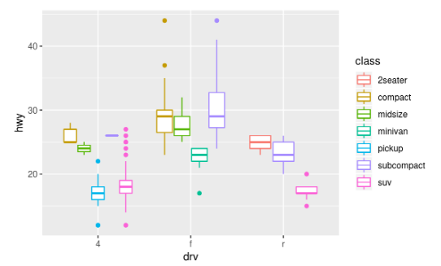
Position adjustments-Exercises
4. What’s the default position adjustment for geom_boxplot()? Create a visualization of the mpg dataset that demonstrates it.
The default position for geom_boxplot() is "dodge2", which is a shortcut for position_dodge2.
This position adjustment does not change the vertical position of a geom but moves the geom horizontally to avoid overlapping other geoms.
ggplot(data = mpg, aes(x = drv, y = hwy, colour = class)) + geom_boxplot()

Slide 77
Sub Topic:Coordinate Systems – Refer Video 4
Coordinate systems are probably the most complicated part of ggplot2.
The default coordinate system is the Cartesian coordinate system where the x and y position act independently to find the location of each point.
coord_flip() switches the x- and y-axes.
This is useful (for example) horizontal boxplots.

Slide 78

Sub Topic:Coordinate Systems – Refer Video 4
ggplot(data = mpg, mapping = aes(x = class, y = hwy)) + geom_boxplot()
ggplot(data = mpg, mapping = aes(x = class, y = hwy)) + geom_boxplot() + coord_flip()

Slide 79

Sub Topic:Coordinate Systems – Refer Video 4
coord_quickmap() sets the aspect ratio correctly for maps.
This is very important if you’re plotting spatial data with ggplot2
Install.packages(“maps”)
Library(maps)
nz <- map_data("nz")
ggplot(nz, aes(long, lat, group = group)) + geom_polygon(fill = "white", color = "black")
ggplot(nz, aes(long, lat, group = group)) + geom_polygon(fill = "white", color = "black") + coord_quickmap()

Slide 80

Sub Topic:Coordinate Systems – Refer Video 4
coord_polar() uses polar coordinates.
Polar coordinates reveal an interesting connection between a bar chart and a Coxcomb chart:
bar <- ggplot(data = diamonds) + geom_bar( mapping = aes(x = cut, fill = cut), show.legend = FALSE, width = 1 ) + labs(x = NULL, y = NULL)
bar + coord_flip()
bar + coord_polar()

Slide 81

Coordinate systems—Exercises –Refer Video 4
1.Turn a stacked bar chart into a pie chart using coord_polar().
A pie chart is a stacked bar chart with the addition of polar coordinates. Take this stacked bar chart with a single category.
ggplot(mpg, aes(x = drv, fill = drv)) + geom_bar()

Slide 82

Coordinate systems—Exercises –Refer Video 4
Now add coord_polar() to create pie chart.
ggplot(mpg, aes(x = drv, fill = drv)) + geom_bar(width = 1) + coord_polar()

Slide 83
Coordinate systems—Exercises –Refer Video 4
2. What does labs() do? Read the documentation.
The labs function adds axis titles, plot titles, and a caption to the plot.
ggplot(data = mpg, mapping = aes(x = class, y = hwy)) +
geom_boxplot() +
coord_flip() +
labs( y = "Highway MPG", x = "Year", title = "Highway MPG by car class", subtitle = "1999-2008", caption = "Source: http://fueleconomy.gov" )

Slide 84
Coordinate systems—Exercises –Refer Video 4
3. What’s the difference between coord_quickmap() and coord_map()?
The coord_map() function uses map projections to project the three-dimensional Earth onto a two-dimensional plane.
By default, coord_map() uses the Mercator projection. This projection is applied to all the geoms in the plot.
The coord_quickmap() function uses an approximate but faster map projection.
This approximation ignores the curvature of Earth and adjusts the map for the latitude/longitude ratio.

Slide 85
Coordinate systems—Exercises –Refer Video 4
4. What does the plot below tell you about the relationship between city and highway mpg? Why is coord_fixed() important? What does geom_abline() do?
ggplot(data = mpg, mapping = aes(x = cty, y = hwy)) + geom_point() + geom_abline() + coord_fixed()
The function coord_fixed() ensures that the line produced by geom_abline() is at a 45-degree angle. A 45-degree line makes it easy to compare the highway and city mileage to the case in which city and highway MPG were equal

Slide 86
Topic: Workflow: Basics Sub Topic: Coding Basics – Refer Video 5
Use R as a calculator:
1 / 200 * 30
#> [1] 0.15
(59 + 73 + 2) / 3
#> [1] 44.7
sin(pi / 2)
#> [1] 1
Create new objects with <-:
x <- 3 * 4
When reading that code say “object name gets value” .

Slide 87
Sub Topic: What’s in a Name? – Refer Video 5
Object names must start with a letter, and can only contain letters, numbers, _, and ..
inspect an object by typing its name:
x
#> [1] 12
Make yet another assignment:
r_rocks <- 2 ^ 3
Let’s try to inspect it:
r_rock
#> Error: object 'r_rock' not found
R_rocks
#> Error: object 'R_rocks' not found
Case matters.

Slide 88
Sub Topic:Calling functions – Refer Video 5
R has a large collection of built-in functions that are called like this:
function_name(arg1 = val1, arg2 = val2, ...)
seq(1, 10)
#> [1] 1 2 3 4 5 6 7 8 9 10
y <- seq(1, 10, length.out = 5)
y
#> [1] 1.00 3.25 5.50 7.75 10.00

Slide 89
Workflow Basics—Exercises – Refer Video 5
1. Why does this code not work?
my_variable <- 10
my_varıable
#> Error in eval(expr, envir, enclos):
#> object 'my_varıable' not found
Look carefully! (This may seem like an exercise in pointlessness, but training your brain to notice even the tiniest difference will pay off when programming.)
The font is different to represent variable name

Slide 90
Workflow Basics—Exercises – Refer Video 5
2. Tweak each of the following R commands so that they run correctly:
library(tidyverse)
ggplot(dota = mpg) + geom_point(mapping = aes(x = displ, y = hwy))
This error is a result of a typo, dota instead of data.
3. Press Alt-Shift-K. What happens? How can you get to the same place using the menus?
This gives a menu with keyboard shortcuts. This can be found in the menu under Tools -> Keyboard Shortcuts Help

Slide 91

Unit I Summary

